Slide 1
Bounding Box Regression with Uncertainty
for Accurate Object Detection
Author: QChen
Date: May 21 2019
汇报人：第PPT

Slide 2
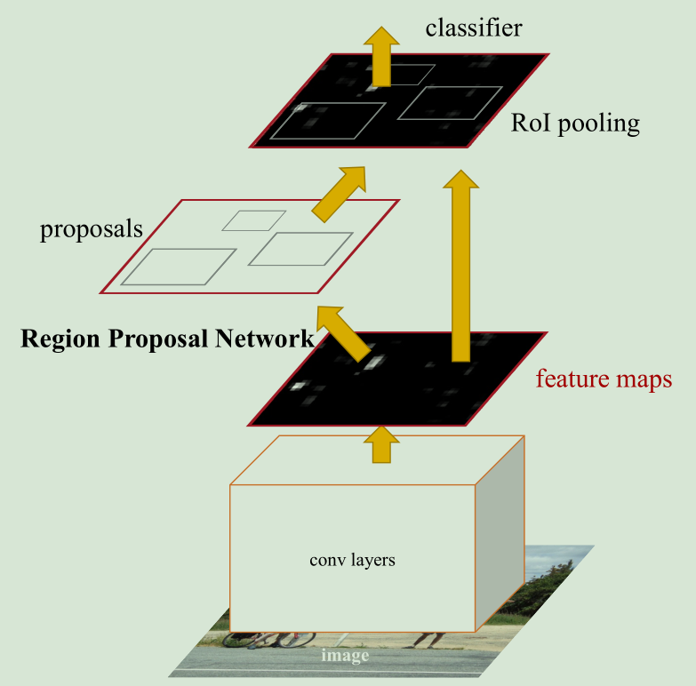
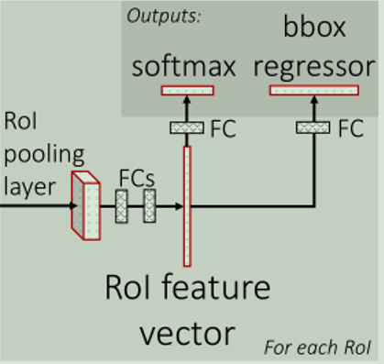
BBR with Uncertainty
Foresight Review
Faster RCNN Architecture

Slide 3

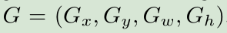
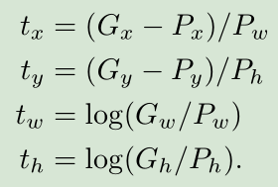
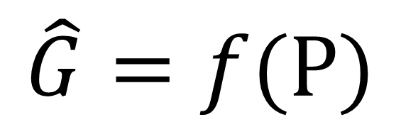
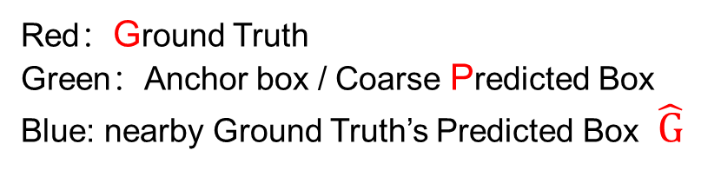
BBR with Uncertainty
Foresight Review
Bounding Box Regression
$$\hat{G}=f(P)$$
Red：Ground Truth
Green：Anchor box / Coarse Predicted Box
Blue: nearby Ground Truth’s Predicted Box $\hat{G}$

Slide 4

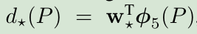
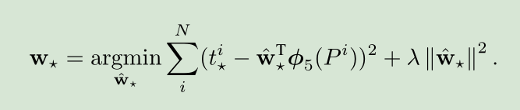
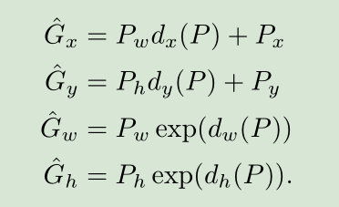
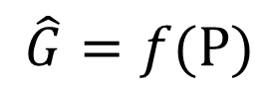
BBR with Uncertainty
Foresight Review
Bounding Box Regression
$$\hat{G}=f(P)$$
GIOU

Slide 5
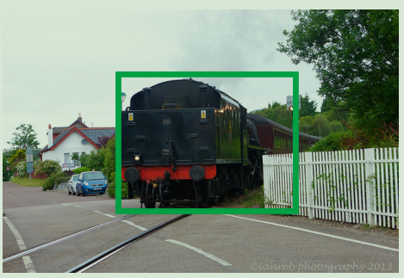
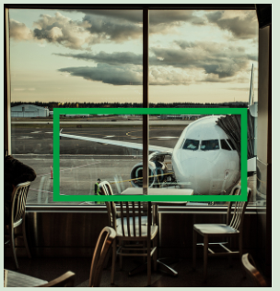
BBR with Uncertainty

Slide 6
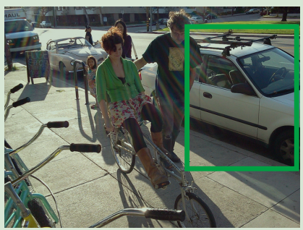
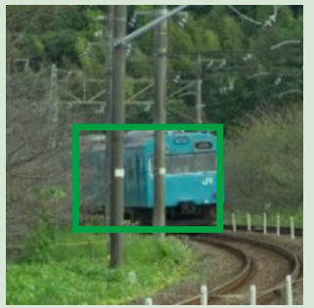
BBR with Uncertainty
we observe that the ground-truth bounding boxes
are inherently ambiguous in some cases.

Slide 7
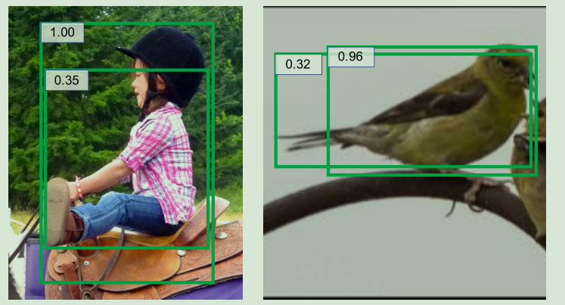
BBR with Uncertainty

Slide 8
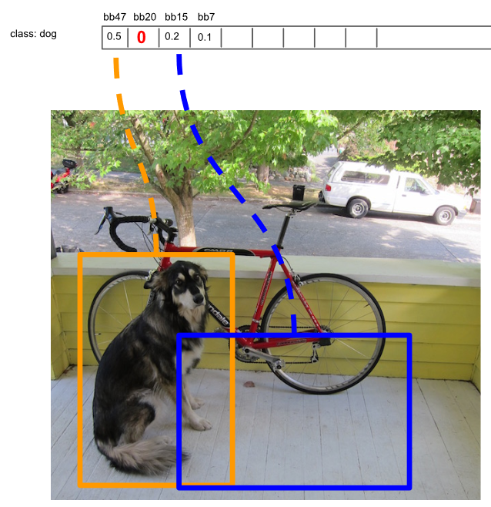
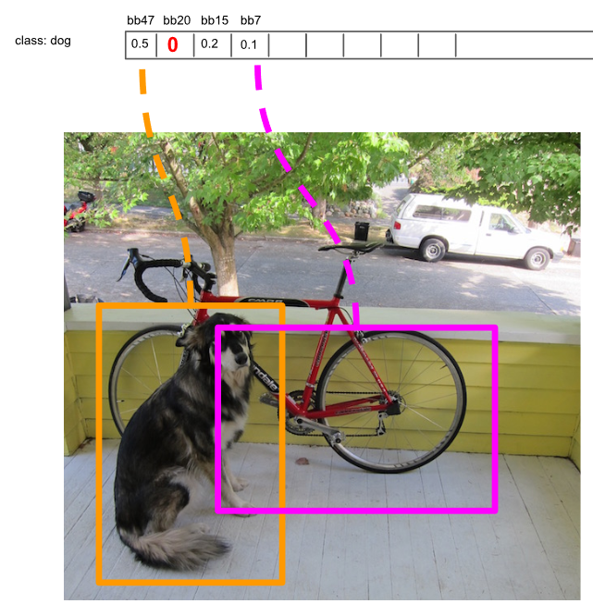
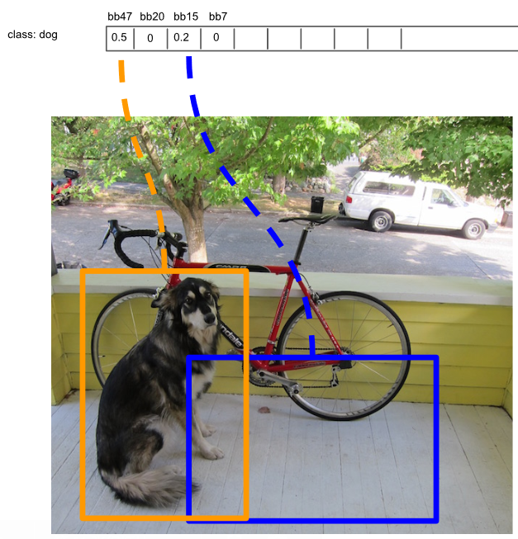
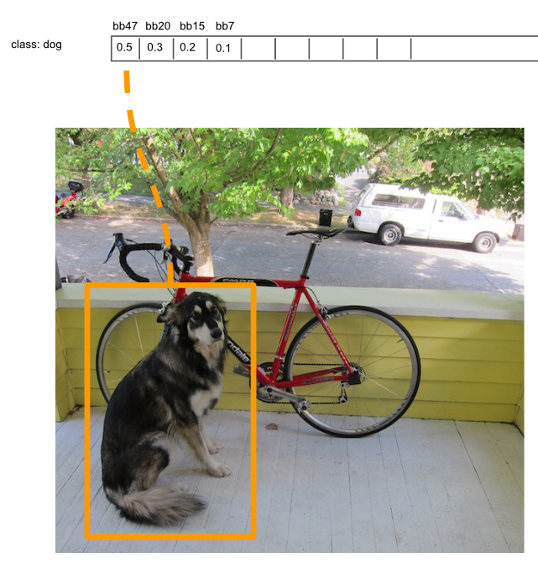
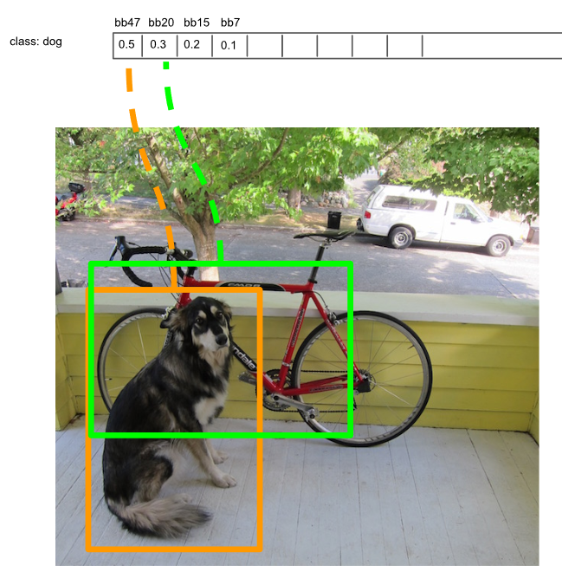
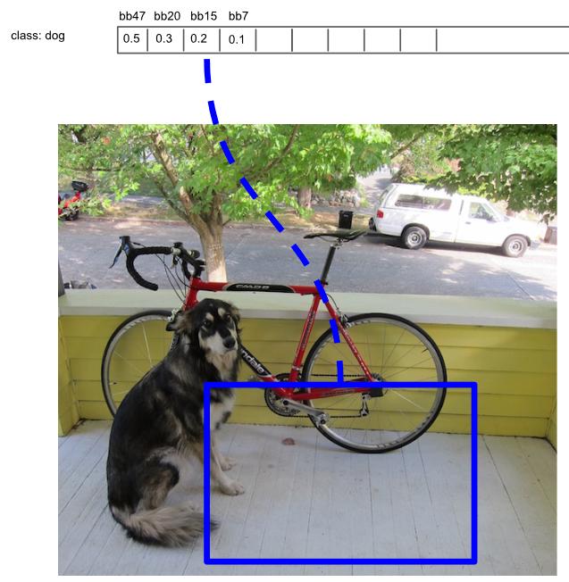
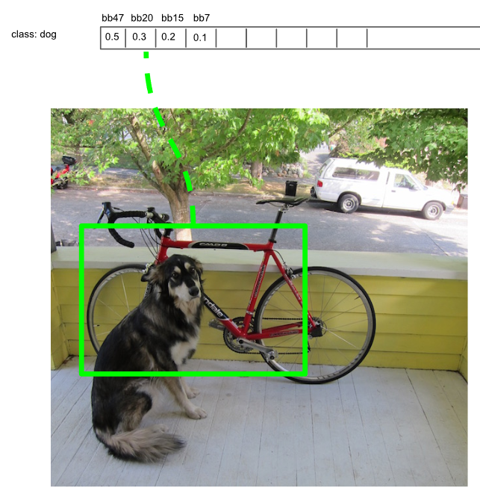
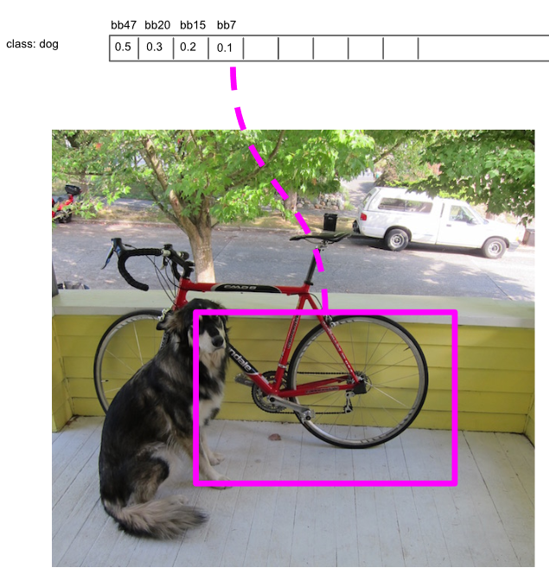
BBR with Uncertainty
NMS Algorithm
Soft NMS
Learning NMS

Slide 9
BBR with Uncertainty
KL Loss
1. bounding box regression method
2. localization uncertainty
we first model the bounding box prediction and ground-truth bounding box
as Gaussian distribution and Dirac delta function respectively.
Then the new bounding box regression loss is defined
as the KL divergence of the predicted distribution and ground-truth distribution.

Slide 10
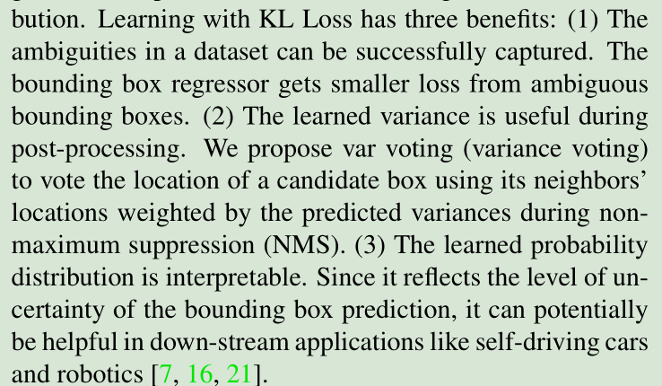
BBR with Uncertainty
KL Loss

Slide 11
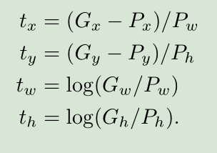
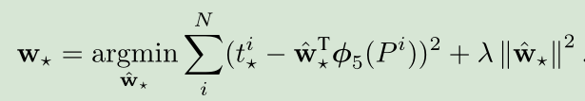
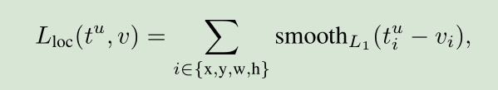
BBR with Uncertainty
1. Bounding Box parameterization
LOSS

Slide 12
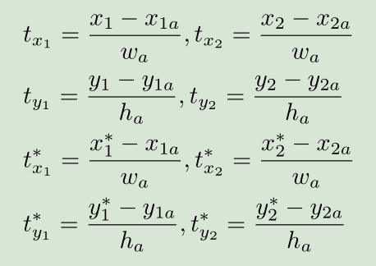
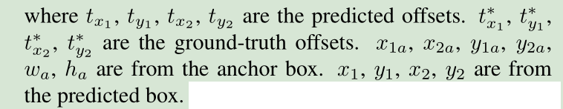
BBR with Uncertainty
1. Bounding Box parameterization

Slide 13
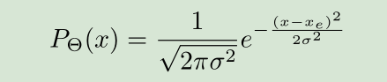
BBR with Uncertainty
1. Bounding Box parameterization
We aim to estimate the localization confidence along with the location.
Θ is the set of learnable parameters.
Xe is the estimated bounding box location.
σ → 0 ?

Slide 14
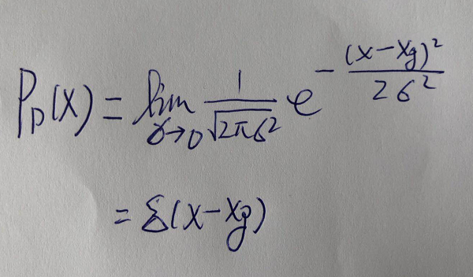
BBR with Uncertainty
1. Bounding Box parameterization
Xg is the ground-truth bounding box location.

Slide 15
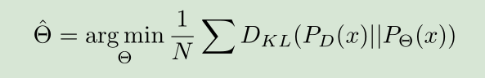
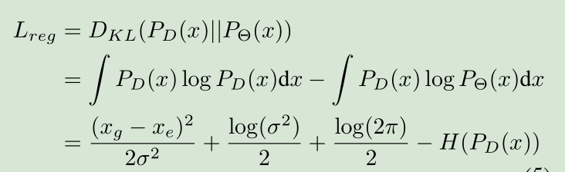
BBR with Uncertainty
2. Bounding Box Regression with KL Loss

Slide 16
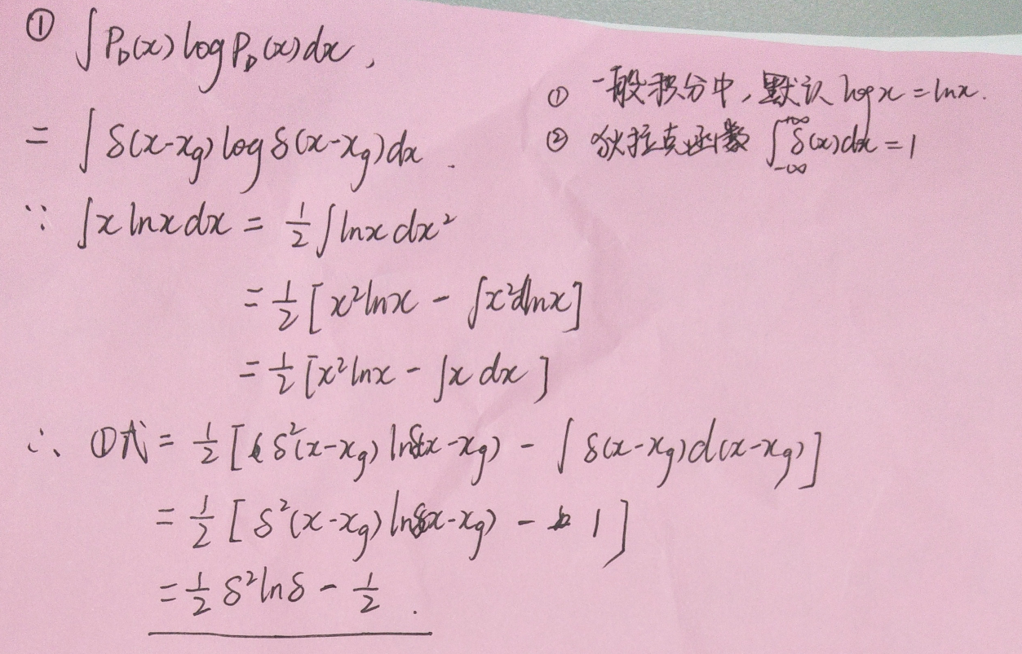
BBR with Uncertainty

Slide 17
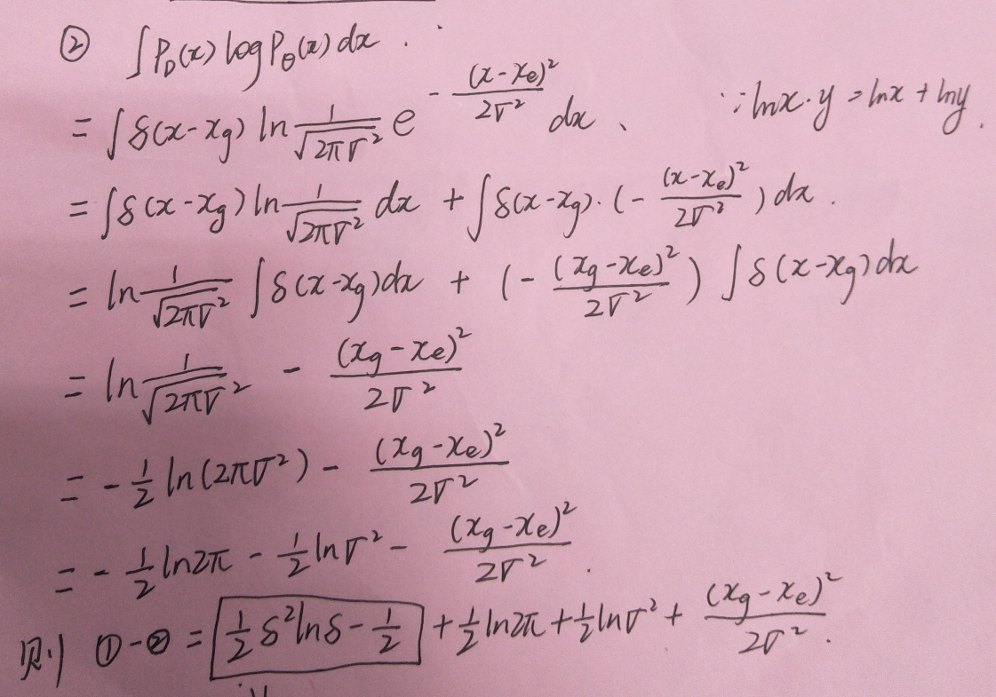
BBR with Uncertainty

Slide 18
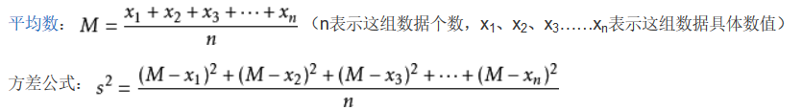
BBR with Uncertainty

Slide 19
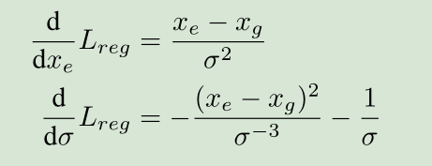
BBR with Uncertainty
2. Bounding Box Regression with KL Loss

Slide 20
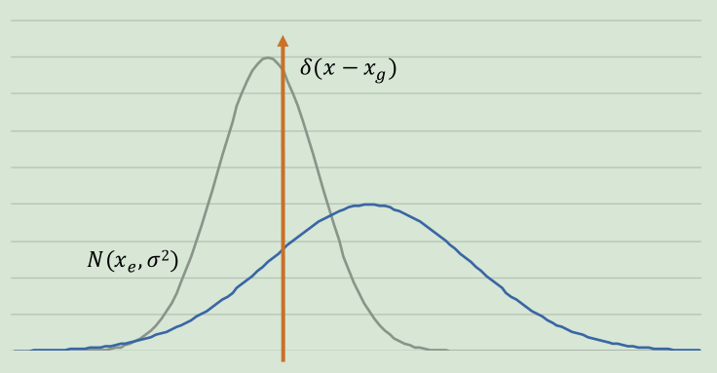
BBR with Uncertainty
2. Bounding Box Regression with KL Loss
when the location Xe is estimated inaccurately, we expect the network to be able to predict larger variance σ2 so that Lreg will be lower.

Slide 21
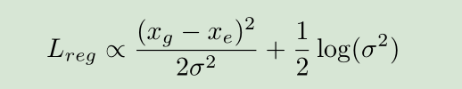
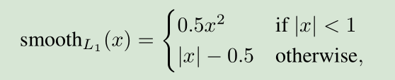
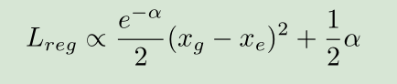
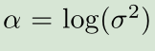
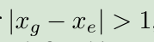
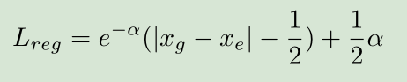
BBR with Uncertainty
2. Bounding Box Regression with KL Loss

Slide 22
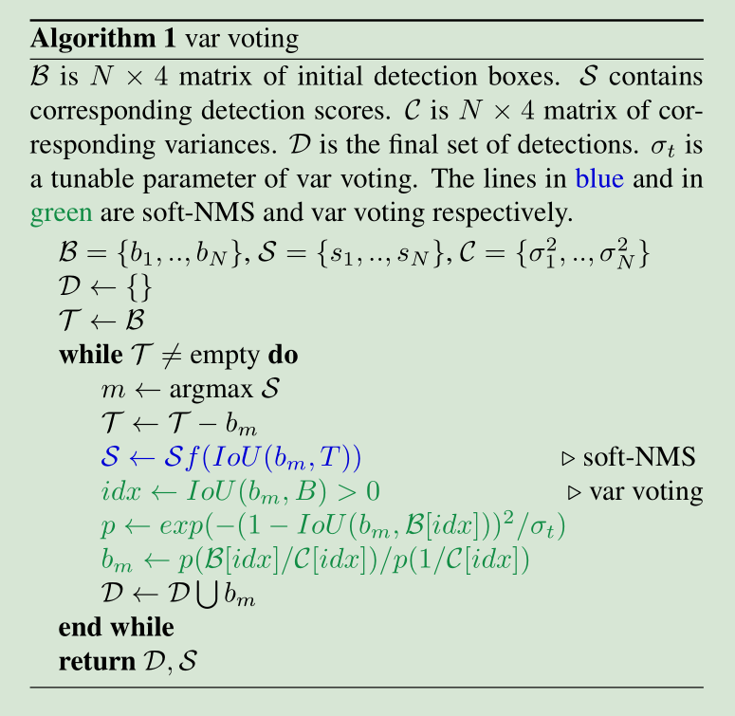
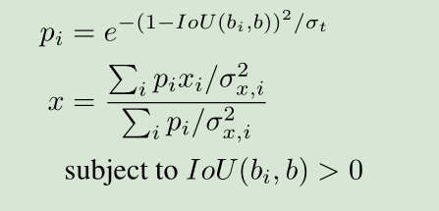
BBR with Uncertainty
3. Variance Voting

Slide 23
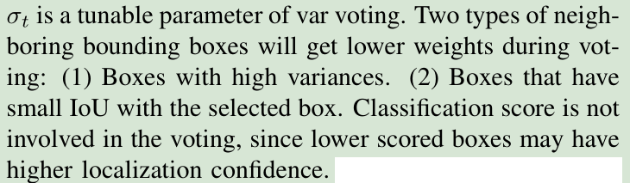
BBR with Uncertainty
3. Variance Voting

Slide 24
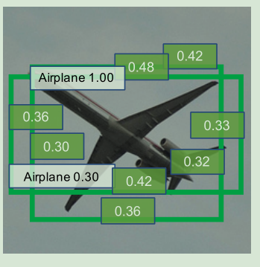
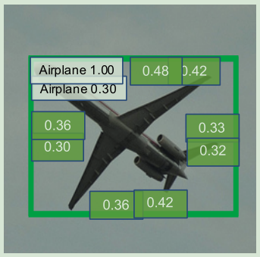
BBR with Uncertainty
3. Variance Voting

Slide 25
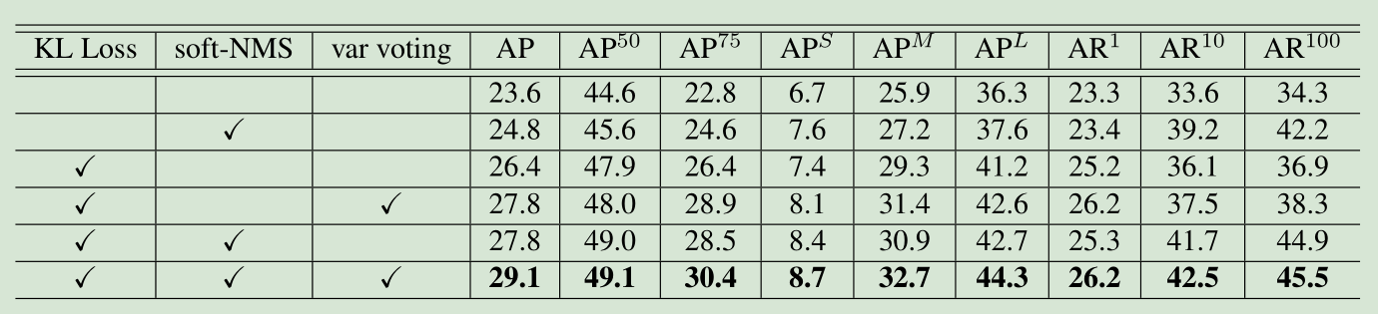
BBR with Uncertainty
4. Experiments
The baseline model is VGG-16 Faster R-CNN

Slide 26

BBR with Uncertainty
4. Experiments
ResNet-50 Faster R-CNN

Slide 27

BBR with Uncertainty
4. Experiments
ResNet-50-FPN Mask R-CNN

Slide 28

BBR with Uncertainty
4. Experiments
When σt = 0, var voting is not activated.
ResNet-50 Faster R-CNN

Slide 29

BBR with Uncertainty
4. Experiments

Slide 30

BBR with Uncertainty
4. Experiments

Slide 31


BBR with Uncertainty

